Slide 1
WELCOME

Slide 2
PROJECT REVIEW MEETING-03.10.2012

Slide 3
ONGOING PROJECT -1-ROB AT PARAPPANANGADI-PROGRESS GRAPH-28.09.12

Slide 4
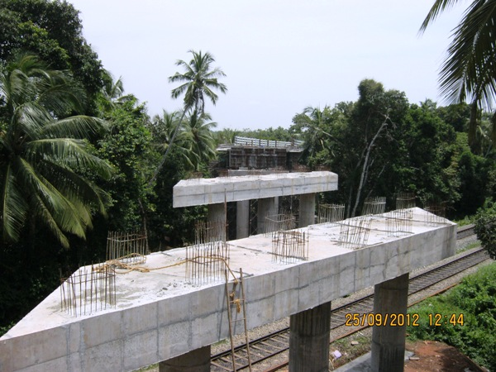
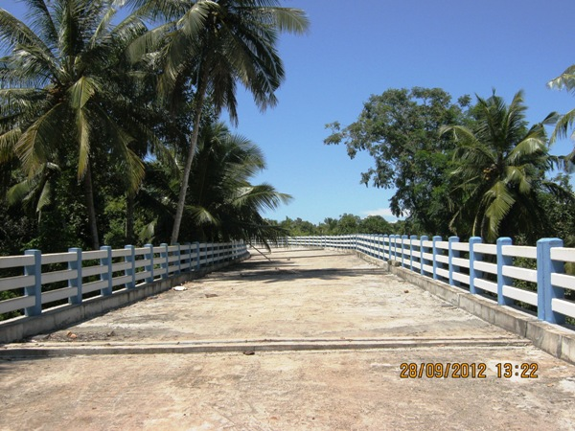
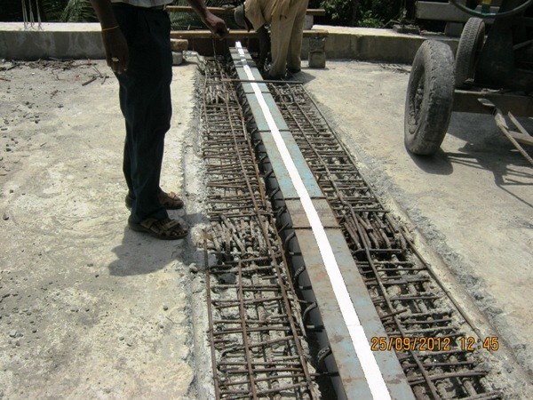
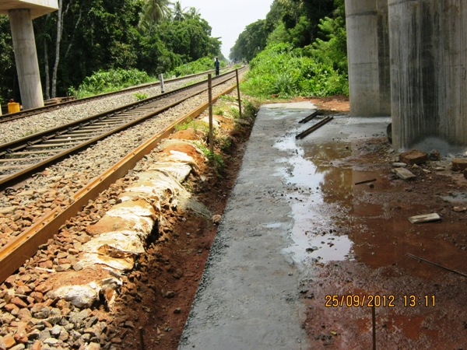
ONGOING PROJECT-1-PROGRESS PHOTOS-ROB AT PARAPPANANGADI-28.09.12

Slide 5
PARAPPANANGADI ROB-PROJECT STATUS REPORT AS ON SEPTEMBER 2012
Si No | Activity Description | Total Quantity | Cumulative progress upto Sep12 | Balance work up to Sep 12 | Cumulative delay in days from Baseline | Work planned for Sep 12 | Actual work done-Sep12 | Delay in Qty in Sep 12 | Work Planned for next Month | Remarks
1 | Pile-calicut Side | 30 | 30 | 0 |  | 0 | 0 | 0
2 | Pile-NH Side | 33 | 33 | 0 |  | 0 | 0 | 0
3 | Pile-calicut Side(Railway) | 10 | 10 | 0 |  | 0 | 0 | 0
4 | Pile-NH Side (Railway) | 10 | 10 | 0 |  | 0 | 0 | 0
5 | Pile cap-calicut Side | 10 | 10 | 0 |  | 0 | 0 | 0
6 | Pile cap-NH Side | 11 | 11 | 0 |  | 0 | 0 | 0
7 | Pile cap-calicut Side (Railway) | 2 | 2 | 0 |  | 0 | 0 | 0
8 | Pile cap-NH Side (Railway) | 2 | 2 | 0 |  | 0 | 0 | 0
9 | Pier-Calicut Side | 10 | 10 | 0 |  | 0 | 0 | 0
10 | Pier-NH Side | 11 | 11 | 0 |  | 0 | 0 | 0
11 | Pier-Calicut Side (Railway) | 2 | 2 | 0 |  | 0 | 0 | 0
12 | Pier-NH Side (Railway) | 2 | 2 | 0 |  | 0 | 0 | 0
13 | Pier Cap-Calicut Side | 10 | 10 | 0 |  | 0 | 0 | 0
14 | Pier Cap-NH Side | 11 | 11 | 0 |  | 0 | 0 | 0
15 | Pier Cap-Calicut Side (Railway) | 2 | 2 | 0 |  | 0 | 0 | 0
16 | Pier Cap-NH Side (Railway) | 2 | 2 | 0 |  | 0 | 0 | 0
17 | Girder-Calicut Side | 10 | 10 | 0 |  | 0 | 0 | 0
18 | Girder-NH Side | 11 | 11 | 0 |  | 1 | 1 | 0
19 | Girder-Calicut Side (Railway) | 2 | 0 | 2 |  | 1 | 1 | 0
20 | Girder-NH Side (Railway) | 1 | 0 | 1 |  | 0 | 0 | 0
21 | Deck Slab-Calicut Side | 10 | 10 | 0 |  | 0 | 0 | 0
22 | Deck Slab-NH Side | 11 | 11 | 0 |  | 1 | 1 | 0
23 | Deck Slab-Calicut Side (Railway) | 2 | 0 | 2 |  | 0 | 0 | 0
24 | Deck Slab-NH Side (Railway) | 1 | 0 | 1 |  | 0 | 0 | 0
25 | Handrails & Kerb-Calicut side | 100% | 100% | 0% |  | 10% | 10% | 0%
26 | Handrails & KerbNH side | 100% | 100% | 0% |  | 0% | 0% | 0%
27 | Handrails & Kerb-Calicut side (Railway) | 0% | 0% | 0% |  | 0% | 0% | 0%
28 | Handrails & KerbNH side (Railway) | 0% | 0% | 0% |  | 0% | 0% | 0%
29 | RE Wall-Calicutside | 100% | 100% | 0% |  | 0% | 0% | 0%
30 | RE Wall-NH side | 100% | 100% | 0% |  | 0% | 0% | 0%
31 | RC Wall-Calicut side | 100% | 100% | 0% |  | 0% | 0% | 0%
32 | RC Wall-NH side | 100% | 100% | 0% |  | 0% | 0% | 0%
33 | Road work-WBM-Calicutside | 100% | 0% | 100% |  | 30% | 0% | 30%
34 | Road Work-WBM-NH side | 100% | 100% | 0% |  | 0% | 0% | 0%
35 | Road work-Calicutside (Railway) | 0% | 0% | 0% |  | 0% | 0% | 0%
36 | Road Work-NH side (Railway) | 0% | 0% | 0% |  | 0% | 0% | 0%
37 | Dirt wall AP2 | 100% | 100% | 0% |  | 0% | 0% | 0%
38 | Dirt wall AP1 | 100% | 100% | 0% |  | 0% | 0% | 0%
39 | Painting | 100% | 100% | 0% |  | 0% | 0% | 0%
40 | Expansion joint | 21 | 21 | 0 |  | 0 | 0 | 0
41 | Miscellaneous works | 100% | 100% | 0% |  | 0% | 0% | 0%

Slide 6
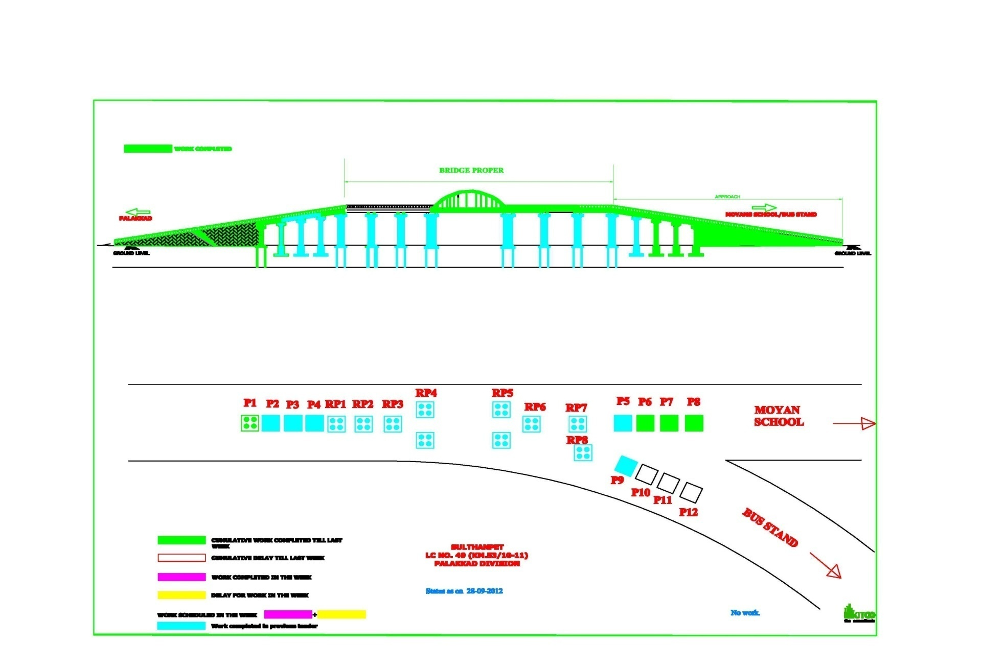
ONGOING PROJECT -2-ROB AT SULTANPET-PALAKKAD TOWN-PROGRESS GRAPH-28.09.12

Slide 7
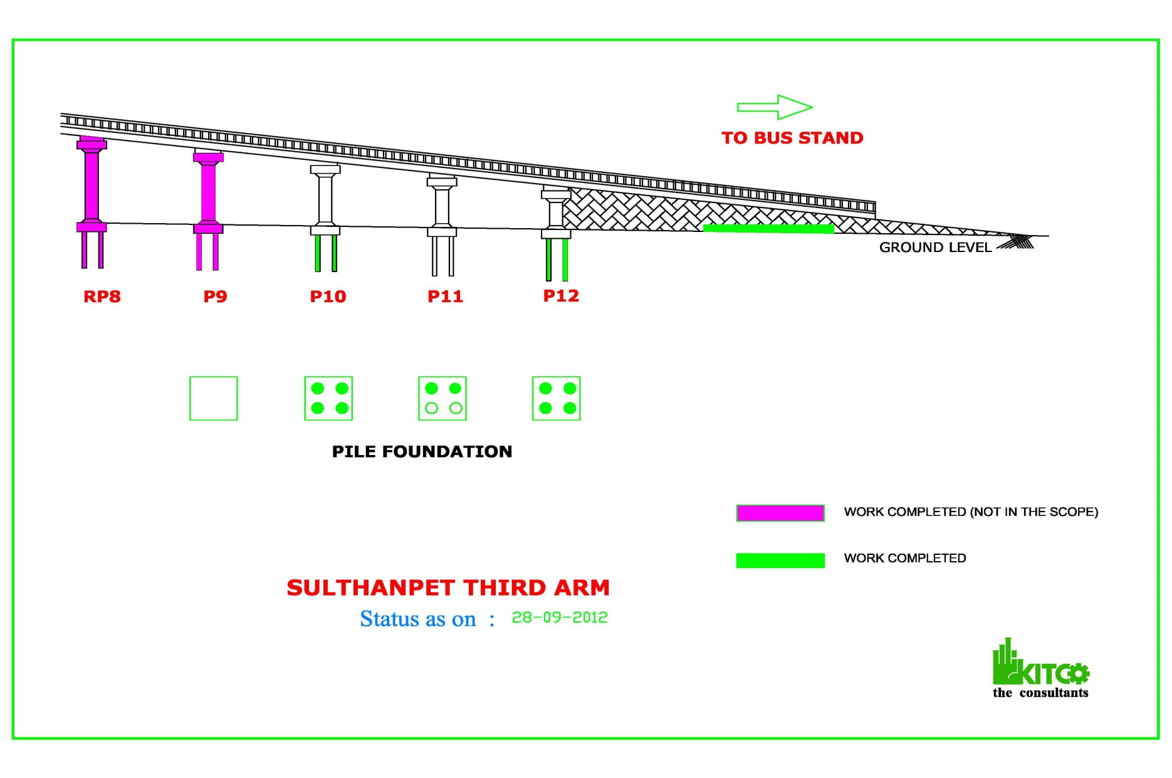
ONGOING PROJECT -2-ROB AT SULTANPET-PALAKKAD TOWN-THIRD ARM-PROGRESS GRAPH-28.09.12

Slide 8
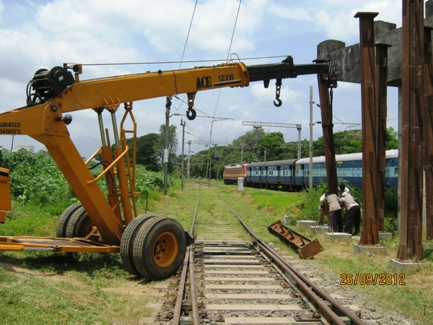
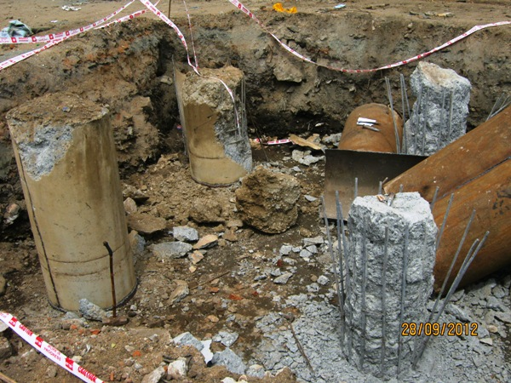
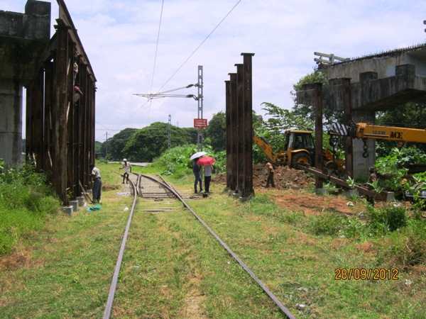
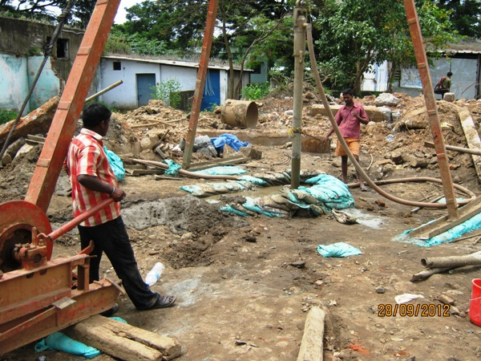
ONGOING PROJECT-2-PROGRESS PHOTOS-ROB AT SULTANPET-PALAKKAD TOWN-28.09.12

Slide 9
SULTANPET ROB-PROJECT STATUS REPORT AS ON SEPTEMBER 2012
Si No | Activity Description | Total Quantity | Cumulative progress upto Sep12 | Balance work up to Sep 12 | Cumulative delay in days from Baseline | Work planned for Sep 12 | Actual work done-Sep12 | Delay in Qty in Sep 12 | Work Planned for next Month | Remarks
1 | PCC for Raft MOYAN Side | 3 | 3 | 0 |  | 0 | 0 | 0
2 | PCC for Raft Palakkad side | 1 | 1 | 0 |  | 0 | 0 | 0
3 | Raft Palakkad Side | 1 | 1 | 0 |  | 0 | 0 | 0
4 | Raft Moyans Side | 3 | 3 | 0 |  | 0 | 0 | 0
5 | Pile - Bus Stand side | 12 | 10 | 2 |  | 12 | 10 | 2
6 | Pile Cap- Bus Stand side | 3 | 0 | 3 |  | 2 | 0 | 2
7 | Pier- Bus Stand side | 3 | 0 | 3 |  | 0 | 0 | 0
8 | Pier Palakkad Side | 1 | 1 | 0 |  | 0 | 0 | 0
9 | Pier Moyans side | 3 | 3 | 0 |  | 0 | 0 | 0
10 | Pier Cap- Bus Stand side | 3 | 0 | 3 |  | 0 | 0 | 0
11 | Pier Cap Palakkad Side | 1 | 1 | 0 |  | 0 | 0 | 0
12 | Pier Cap Moyans side | 3 | 3 | 0 |  | 0 | 0 | 0
13 | Girder- Bus Stand side | 4 | 0 | 4 |  | 1 | 0 | 1
14 | Girder-Land Span-Palakkad Side | 2 | 2 | 0 |  | 0 | 0 | 0
15 | Girder-Land Span-Moyans Side | 4 | 4 | 0 |  | 0 | 0 | 0
16 | Deck Slab- Bus Stand side | 4 | 0 | 4 |  | 0 | 0 | 0
17 | Deck Slab-Land Span-Palakkad Side | 2 | 2 | 0 |  | 0 | 0 | 0
18 | Deck Slab-Land Span-Moyans Side | 4 | 4 | 0 |  | 0 | 0 | 0
19 | Girder-Railway span | 6 | 3 | 3 |  | 1 | 0 | 1
20 | Deck Slab-Railway Span | 6 | 3 | 3 |  | 0 | 0 | 0
21 | Bowstring girder | 2 | 2 | 0 |  | 0 | 0 | 0
22 | Casting of Bow arch bem | 2 | 2 | 0 |  | 0 | 0 | 0
23 | Casting of cross girders (RP4-RP5) | 13 | 13 | 0 |  | 0 | 0 | 0
24 | Casting Bracings-RP4-RP5 | 5 | 5 | 0 |  | 0 | 0 | 0
25 | RE/R WALL PALAKKAD SIDE | 100% | 100% | 0% |  | 0% | 0% | 0%
26 | RE/R WALL MOYAN SCHOOL SIDE | 100% | 100% | 0% |  | 0% | 0% | 0%
27 | HR/FP/KERB Pkd SIDE | 100% | 100% | 0% |  | 0% | 0% | 0%
28 | HR/FP/KERB Moyen's SIDE | 100% | 100% | 0% |  | 0% | 0% | 0%
29 | HR/FP/KERB RAILWAY SPAN | 100% | 100% | 0% |  | 0% | 0% | 0%
30 | Expansion Joint-Land span | 7 | 2 | 5 |  | 0 | 0 | 0
31 | BC/PAINTING | 100% | 75% | 25% |  | 0% | 0% | 0%
32 | Road works-Moyans side | 100% | 100% | 0% |  | 0% | 0% | 0%
33 | Road works-Pkd side | 100% | 100% | 0% |  | 0% | 0% | 0%

Slide 10
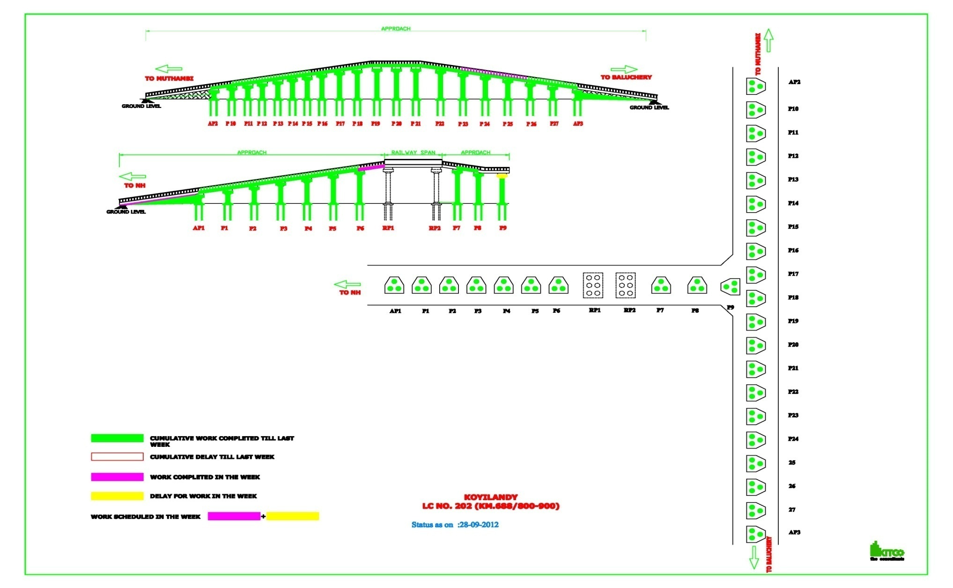
ONGOING PROJECT -3-ROB AT KOILANDY-PROGRESS GRAPH-28.09.12

Slide 11
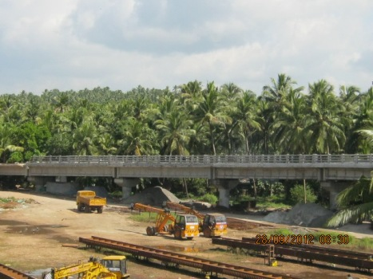
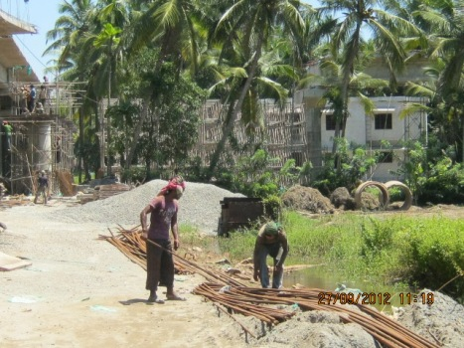
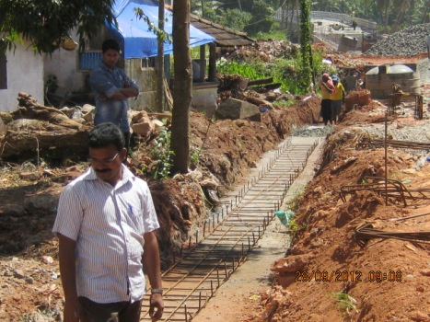
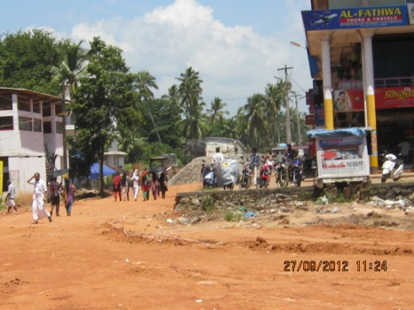
ONGOING PROJECT-3-PROGRESS PHOTOS-ROB AT KOILANDY-28.09.12

Slide 12
KOILANDY ROB-PROJECT STATUS REPORT AS ON SEPTEMBER 2012
Si No | Activity Description | Total Quantity | Cumulative progress upto Sep12 | Balance work up to Sep 12 | Cumulative delay in days from Baseline | Work planned for Sep 12 | Actual work done-Sep12 | Delay in Qty in Sep 12 | Work Planned for next Month | Remarks
1 | Pile-Muthambi Side | 27 | 27 | 0 |  | 0 | 0 | 0
2 | Pile-Thamarachery Side | 33 | 33 | 0 |  | 0 | 0 | 0
3 | Pile-NH Side | 33 | 33 | 0 |  | 0 | 0 | 0
4 | Pile cap-Muthambi Side | 9 | 9 | 0 |  | 0 | 0 | 0
5 | Pile cap-Thamarachery Side | 11 | 11 | 0 |  | 0 | 0 | 0
6 | Pile cap-NH Side | 11 | 11 | 0 |  | 0 | 0 | 0
7 | Pier-Muthambi Side | 9 | 9 | 0 |  | 0 | 0 | 0
8 | Pier-Thamarachery Side | 11 | 11 | 0 |  | 0 | 0 | 0
9 | Pier-NH Side | 11 | 11 | 0 |  | 0 | 0 | 0
10 | Pier Cap-Muthambi Side | 9 | 9 | 0 |  | 0 | 0 | 0
11 | Pier Cap-Thamarachery Side | 11 | 11 | 0 |  | 0 | 0 | 0
12 | Pier Cap-NH Side | 10 | 9 | 1 |  | 1 | 0 | 1
13 | Girder-Muthambi Side | 9 | 9 | 0 |  | 0 | 0 | 0
14 | Girder-Thamarachery Side | 10 | 10 | 0 |  | 0 | 0 | 0
15 | Girder-NH Side | 10 | 8 | 2 |  | 2 | 1 | 1
16 | Deck Slab-Muthambi Side | 9 | 9 | 0 |  | 1 | 1 | 0
17 | Deck Slab-Thamarachery Side | 10 | 10 | 0 |  | 1 | 1 | 0
18 | Deck Slab-NH Side | 10 | 8 | 2 |  | 2 | 0 | 2
7 | Handrails & Kerb-NH side | 9 | 7 | 2 |  | 0 | 0 | 0
8 | Handrails & Kerb-Baluchery side | 10 | 5 | 5 |  | 5 | 5 | 0
9 | Handrails & Kerb-Muthambi side | 10 | 4 | 6 |  | 0 | 0 | 0
13 | RC Wall-NH side | 100% | 90% | 10% |  | 100% | 100% | 0%
14 | RC Wall-Baluchery side | 100% | 50% | 50% |  | 100% | 50% | 50%
15 | RCWall-Muthambi side | 100% | 0% | 100% |  | 25% | 0% | 25%
16 | Expansion Joint-NH side | 12 | 3 | 9 |  | 0 | 0 | 0
17 | Expansion Joint-Baluchery side | 11 | 4 | 7 |  | 5 | 4 | 1
18 | Expansion Joint-Muthambi side | 9 | 7 | 2 |  | 0 | 0 | 0
19 | Road work-NH side | 100% | 0% | 100% |  | 0% | 0% | 0%
20 | Road Work-Baluchery side | 100% | 0% | 100% |  | 0% | 0% | 0%
21 | Road Work-Muthambi side | 100% | 0% | 100% |  | 0% | 0% | 0%

Slide 13
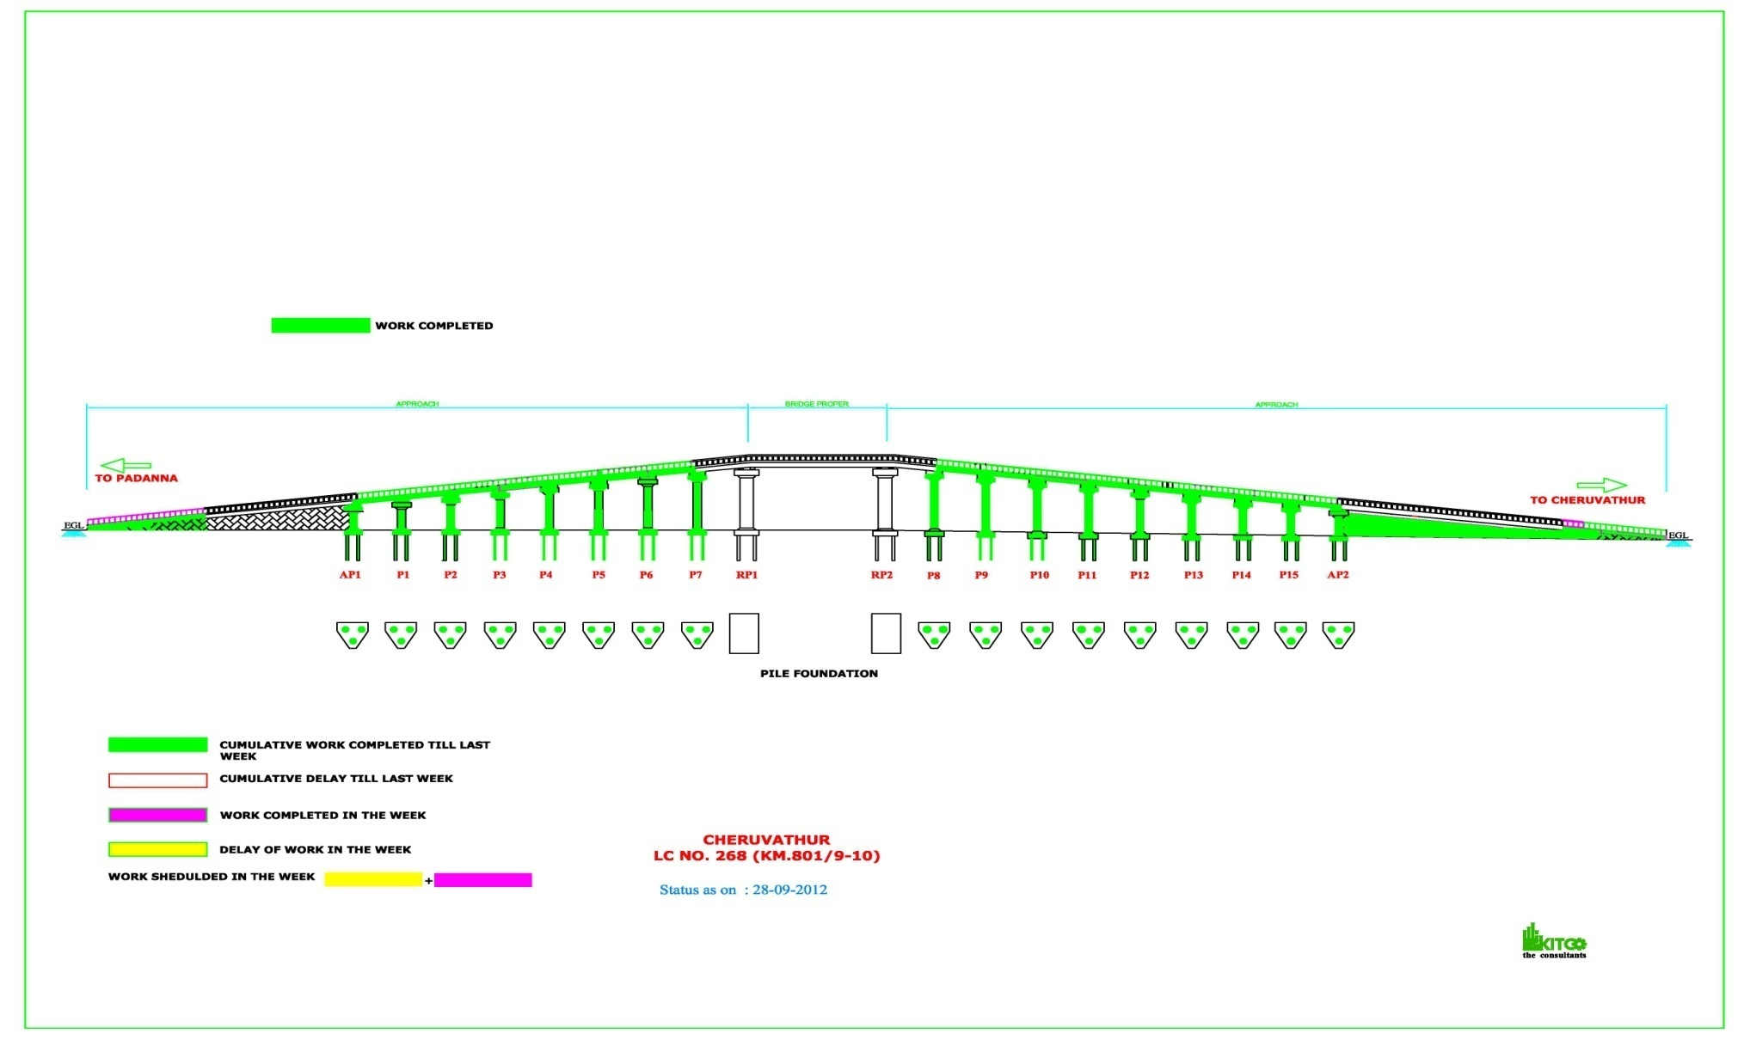
ONGOING PROJECT -4-ROB AT CHERUVATHUR-PROGRESS GRAPH-28.09.12

Slide 14
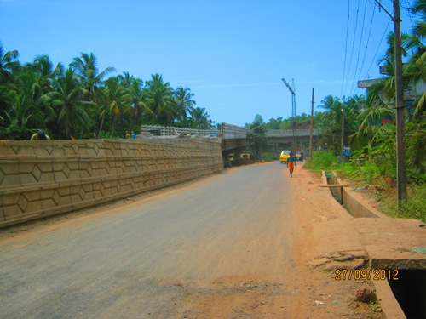
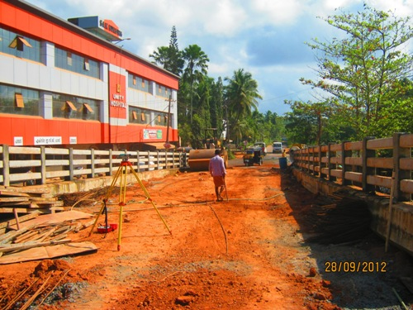
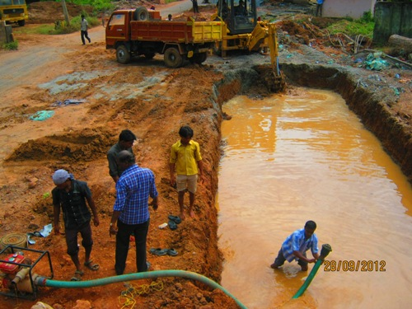
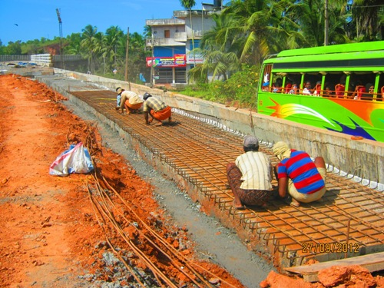
ONGOING PROJECT-4-PROGRESS PHOTOS-ROB AT CHERUVATHUR-28.09.12

Slide 15
CHERUVATHUR ROB-PROJECT STATUS REPORT AS ON SEPTEMBER 2012
Si No | Activity Description | Total Quantity | Cumulative progress upto Sep12 | Balance work up to Sep 12 | Cumulative delay in days from Baseline | Work planned for Sep 12 | Actual work done-Sep12 | Delay in Qty in Sep 12 | Work Planned for next Month | Remarks
1 | Pile-Cheruvathur side | 27 | 27 | 0 |  |  |  | 0
2 | Pile-Padanna side | 24 | 24 | 0 |  |  |  | 0
3 | Pilecap-Cheruvathurside | 9 | 9 | 0 |  |  |  | 0
4 | Pilecap-Padanna side | 8 | 8 | 0 |  |  |  | 0
5 | Pier-Cheruvathur side | 9 | 9 | 0 |  |  |  | 0
6 | Pier-Padanna side | 8 | 8 | 0 |  |  |  | 0
7 | Piercap-Cheruvathur side | 9 | 9 | 0 |  |  |  | 0
8 | Piercap-Padanna side | 8 | 8 | 0 |  |  |  | 0
9 | Girders-Cheruvathur side | 9 | 8 | 1 |  |  |  | 0
10 | Girder-Padanna Side | 8 | 7 | 1 |  |  |  | 0
11 | Deck Slab-Cheruvathur side | 9 | 8 | 1 |  |  |  | 0
12 | Deckslab-Padanna Side | 8 | 7 | 1 |  |  |  | 0
13 | Handrails on Cheruvathur side | 100% | 90% | 10% |  |  |  | 0% |  | Adjacent span to be done
14 | Kerb-Cheruvathur side | 100% | 100% | 0% |  |  |  | 0%
15 | Handrails on Padanna side | 100% | 90% | 10% |  |  |  | 0% |  | Adjacent span to be done
16 | Kerbs - Padanna side | 100% | 100% | 0% |  |  |  | 0%
17 | Handrail on Approch portion-Cheruvathur side | 100% | 100% | 0% |  | 100% | 100% | 0%
18 | Handrail on Approch portion-Padanna side | 100% | 100% | 0% |  | 100% | 100% | 0%
19 | Expansion joint-Cheruvathur side | 10 | 7 | 3 |  | 0 | 0 | 0 |  | Adjacent span,Approach to be done
20 | Expansion joint-Padanna side | 9 | 6 | 3 |  | 0 | 0 | 0 |  | Adjacent span,Approach to be done
21 | RE Panel Erection - Cheruvathur side | 100% | 100% | 0% |  | 15% | 15% | 0%
22 | Retaining Wall -Cheruvathur side | 100% | 100% | 0%
23 | RE Panel Erection - padanna side | 100% | 0% | 100%
24 | Retaining Wall Padanna side | 100% | 100% | 0% |  | 5% | 5% | 0%
25 | Road work Cheruvathur side | 100% | 0% | 100% |  | 30% | 0% | 30%
26 | Road work Padanna side | 100% | 0% | 100% |  | 0% | 0% | 0%

Slide 16
ONGOING PROJECT -5-ROB AT DEVADHAR-PROGRESS GRAPH-28.09.12

Slide 17
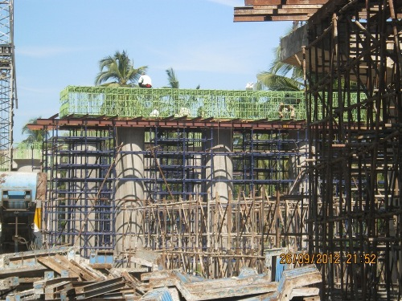
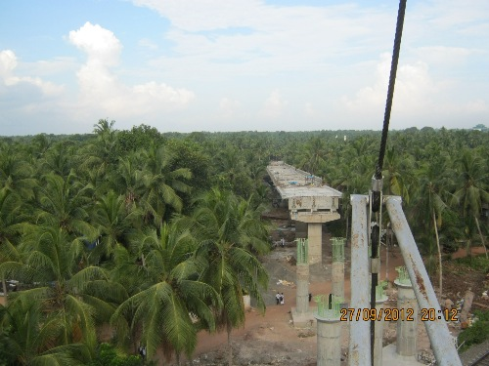
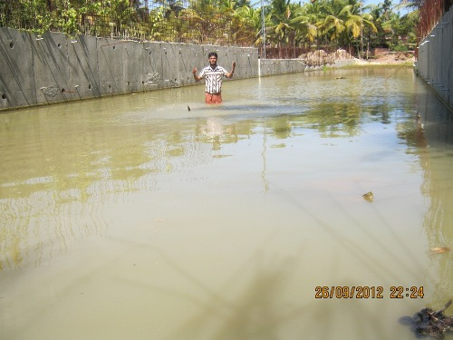
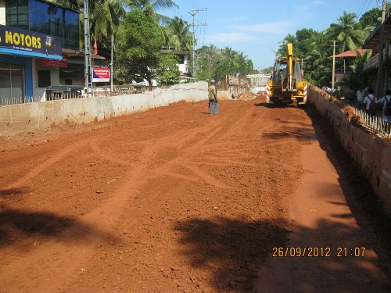
ONGOING PROJECT-5-PROGRESS PHOTOS-ROB AT DEVADHAR-28.09.12

Slide 18
DEVDAR ROB-PROJECT STATUS REPORT AS ON SEPTEMBER 2012
Si No | Activity Description | Total Quantity | Cumulative progress upto Sep12 | Balance work up to Sep 12 | Cumulative delay in days from Baseline | Work planned for Sep 12 | Actual work done-Sep12 | Delay in Qty in Sep 12 | Work Planned for next Month | Remarks
1 | Pile-calicut Side | 48 | 48 | 0 |  | 0 | 0 | 0
2 | Pile-Thirur Side | 24 | 24 | 0 |  | 0 | 0 | 0
3 | Pile cap-calicut Side | 12 | 12 | 0 |  | 0 | 0 | 0
4 | Pile cap-Thirur Side | 6 | 6 | 0 |  | 0 | 0 | 0
5 | Pier-Calicut Side | 12 | 12 | 0 |  | 0 | 0 | 0
6 | Pier-Thirur Side | 6 | 6 | 0 |  | 0 | 0 | 0
7 | Pier Cap-Calicut Side | 12 | 12 | 0 |  | 0 | 0 | 0
8 | Pier Cap-Thirur Side | 6 | 6 | 0 |  | 0 | 0 | 0
9 | Girder-Calicut Side | 12 | 11 | 1 |  | 1 | 1 | 0
10 | Girder-Thirur Side | 6 | 5 | 1 |  | 1 | 1 | 0
11 | Deck Slab-Calicut Side | 12 | 11 | 1 |  | 3 | 3 | 0
12 | Deck Slab-Thirur Side | 6 | 4 | 2 |  | 1 | 0 | 1
13 | Handrails -Calicut side | 12 | 8 | 4 |  | 5 | 3 | 2
14 | Handrails -Thirur side | 6 | 0 | 6 |  | 0 | 0 | 0
13 | Kerb-Calicut side | 12 | 10 | 2 |  | 2 | 2 | 0
14 | KerbThirur side | 6 | 4 | 2 |  | 0 | 0 | 0
15 | RC Wall-Calicut side | 100% | 65% | 35% |  | 0% | 0% | 0%
16 | RC Wall-Thirur side | 100% | 95% | 5% |  | 25% | 20% | 5%
17 | Expansion Joint-Calicut side | 13 | 6 | 7 |  | 4 | 4 | 0
18 | Expansion Joint-Thirur side | 7 | 1 | 6 |  | 0 | 1 | -1
19 | Road work-Calicutside | 100% | 0% | 100% |  | 0% | 0% | 0%
20 | Road Work-Thirur side | 100% | 0% | 100% |  | 0% | 0% | 0%

Slide 19
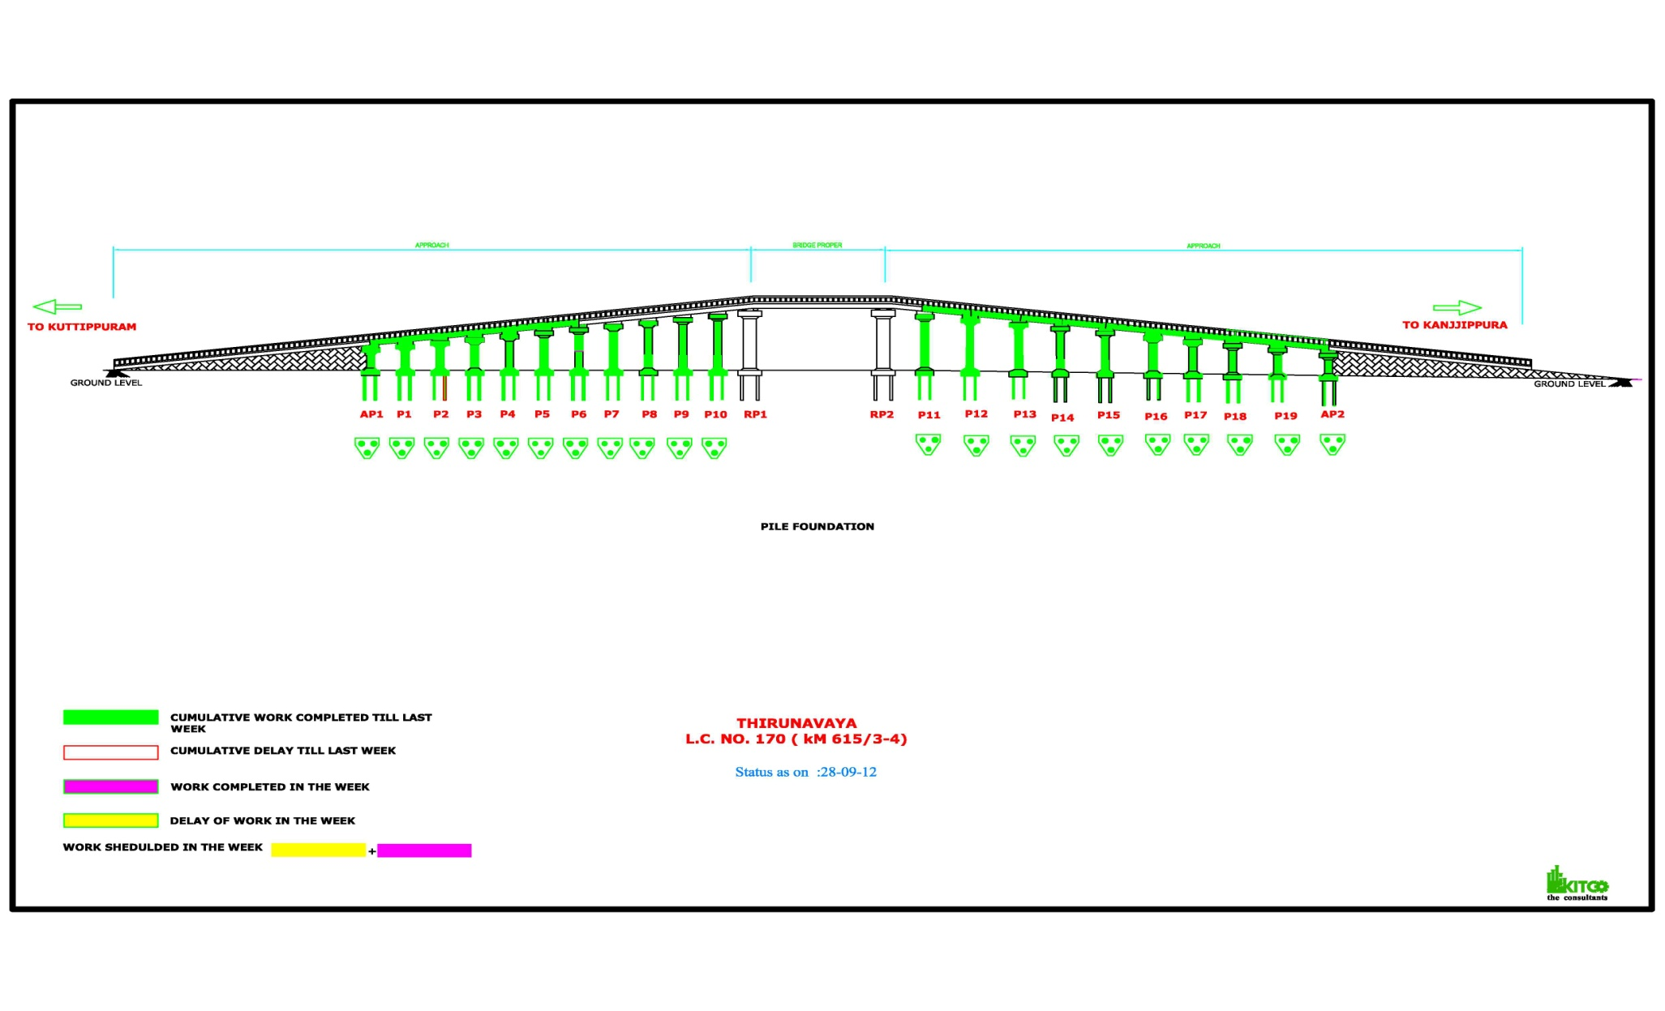
ONGOING PROJECT -6-ROB AT THIRUNNAVAYA-PROGRESS GRAPH-28.09.12

Slide 20
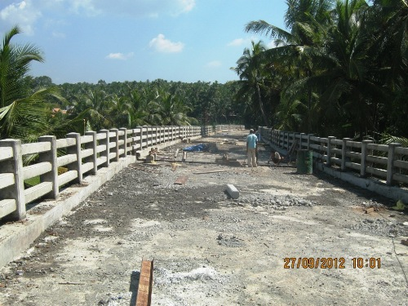
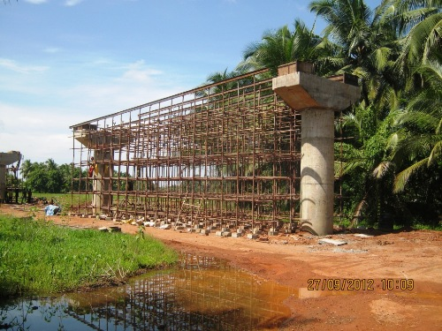
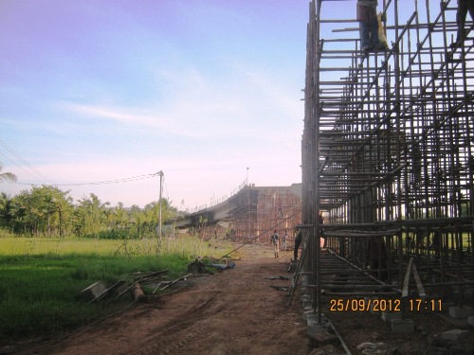
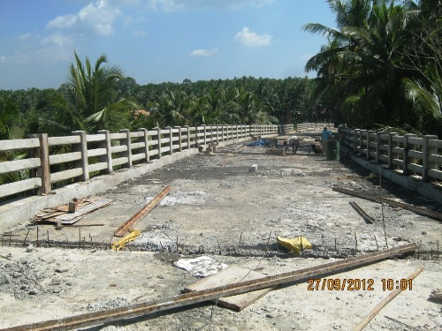
ONGOING PROJECT-6-PROGRESS PHOTOS-ROB AT THIRUNNAVAYA-28.09.12

Slide 21
THIRUNAVAYA ROB-PROJECT STATUS REPORT AS ON SEPTEMBER 2012
Si No | Activity Description | Total Quantity | Cumulative progress upto Sep12 | Balance work up to Sep 12 | Cumulative delay in days from Baseline | Work planned for Sep 12 | Actual work done-Sep12 | Delay in Qty in Sep 12 | Work Planned for next Month | Remarks
1 | Pile-kanjipura Side | 30 | 30 | 0
2 | Pile-kuttipuram Side | 33 | 33 | 0
3 | Pile cap-kanjipura Side | 10 | 10 | 0
4 | Pile cap-kuttipuram Side | 11 | 11 | 0
5 | Pier-kanjipura Side | 10 | 10 | 0
6 | Pier-kuttipuram Side | 11 | 11 | 0
7 | Pier Cap-kanjipura Side | 10 | 10 | 0 |  |  |  | 0
8 | Pier Cap-kuttipuram Side | 11 | 11 | 0 |  |  |  | 0
9 | Girder-kanjipura Side | 9 | 9 | 0 |  |  |  | 0
10 | Girder-kuttipuram Side | 10 | 6 | 4 |  | 2 | 2 | 0
11 | Deck Slab-kanjipura Side | 9 | 9 | 0 |  |  |  | 0
12 | Deck Slab-kuttipuram Side | 10 | 6 | 4 |  | 2 | 2 | 0
13 | Handrails on kanjipura side | 9 | 5 | 4 |  | 2 | 2 | 0
14 | Kerb-kanjipura side | 9 | 8 | 1 |  | 0 | 0 | 0
15 | Handrails on kuttipuram side | 10 | 0 | 10 |  |  |  | 0
16 | Kerb kuttipuram side | 10 | 5 | 5 |  | 2 | 2 | 0
17 | RC Wall-kanjipura side | 100% | 0% | 100%
18 | RC Wall-kuttipuram side | 100% | 26% | 74%
19 | Expansion Joint-kanjipura side | 10 | 0 | 10 |  | 4 | 4 | 0
20 | Expansion Joint-kuttipuram side | 12 | 0 | 12
21 | Road work-kanjipuraside | 100% | 0% | 100%
22 | Road Work-kuttipuram side | 100% | 0% | 100%

Slide 22
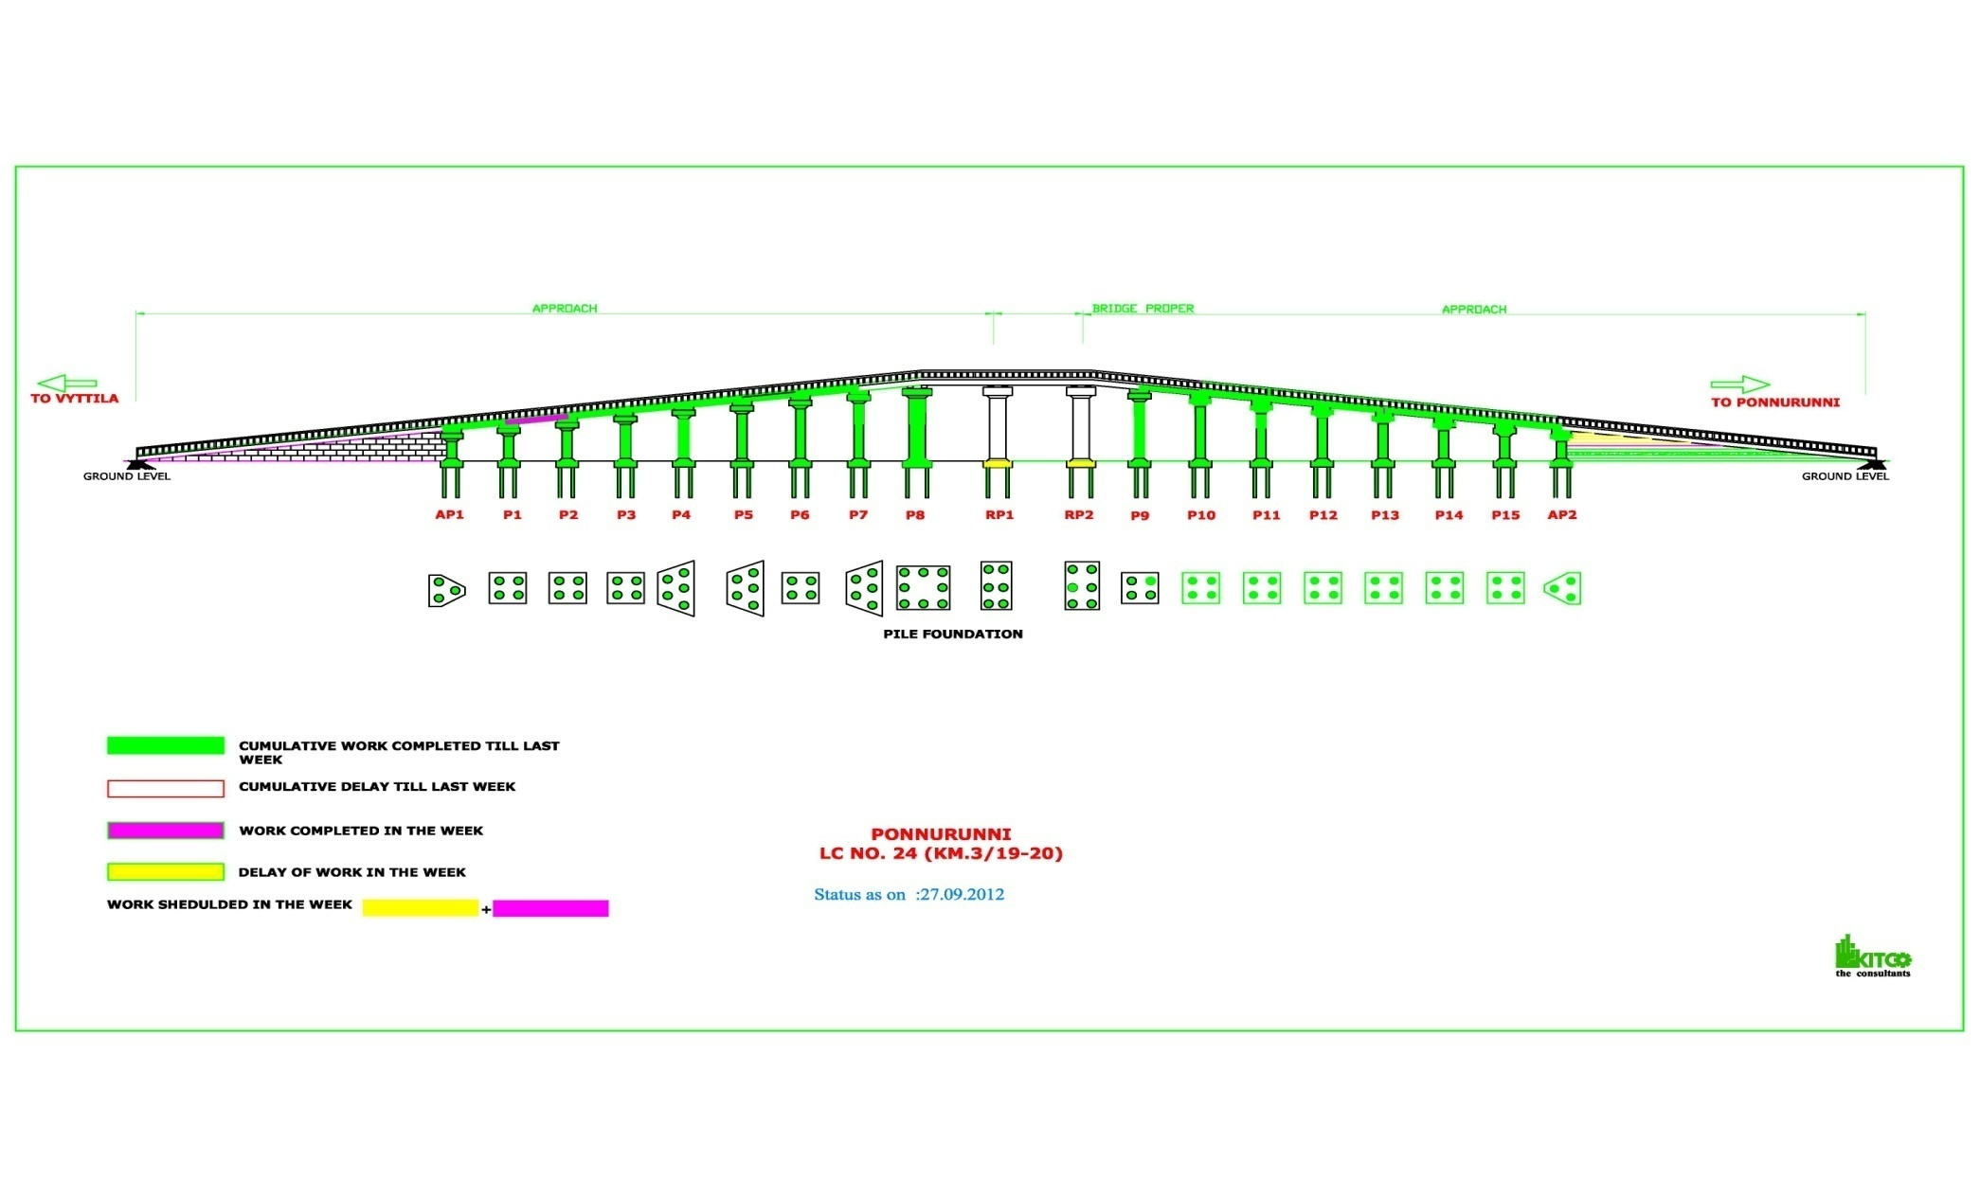
ONGOING PROJECT -7-ROB AT PONNURUNNI-PROGRESS GRAPH-28.09.12

Slide 23
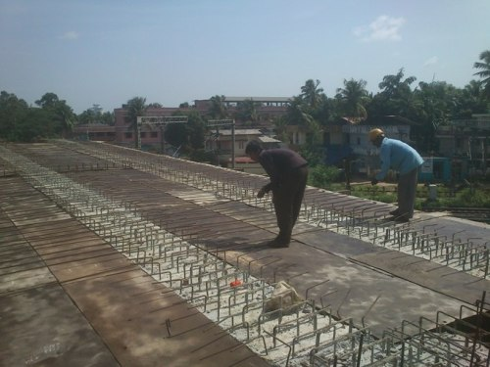
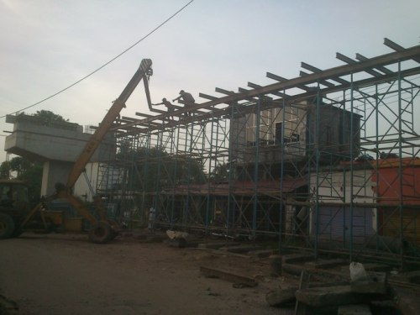
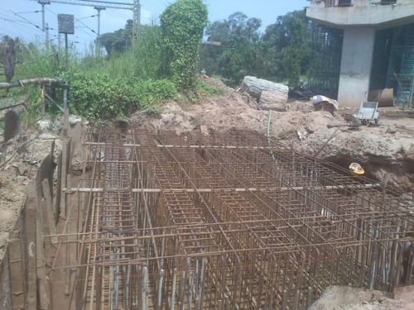
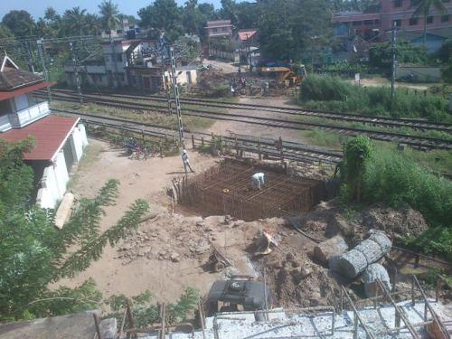
ONGOING PROJECT-7-PROGRESS PHOTOS-ROB AT PONNURUNNI-28.09.12

Slide 24
PONNURUNNI ROB-PROJECT STATUS REPORT AS ON SEPTEMBER 2012
Si No | Activity Description | Total Quantity | Cumulative progress upto Sep12 | Balance work up to Sep 12 | Cumulative delay in days from Baseline | Work planned for Sep 12 | Actual work done-Sep12 | Delay in Qty in Sep 12 | Work Planned for next Month | Remarks
1 | PILE Palarivattom side(Approach portion) | 31 | 31 | 0 |  |  |  | 0
2 | PILE Palarivattom side(railway portion) | 6 | 6 | 0 |  |  |  | 0
3 | PILE vytilla side(Approach portion) | 42 | 42 | 0 |  |  |  | 0
4 | PILE vytilla side(railway portion) | 6 | 6 | 0 |  |  |  | 0
5 | PILE CAP Palarivattom side(Approach portion) | 8 | 8 | 0 |  |  |  | 0
6 | PILE CAP Palarivattomside(railway portion) | 1 | 1 | 0 |  | 1 | 1 | 0
7 | PILE CAP vytilla side(Approach portion) | 9 | 9 | 0 |  |  |  | 0
8 | PILE CAP vytilla side(railway portion) | 1 | 0 | 1 |  | 0 | 0 | 0
9 | PIER Palarivattom side(Approach portion) | 8 | 8 | 0 |  |  |  | 0
10 | PIER Palarivattomside(railway portion) | 1 | 0 | 1 |  |  |  | 0
11 | PIER Vytilla side(Approach portion) | 9 | 9 | 0 |  |  |  | 0
12 | PIER vytilla side(railway portion) | 1 | 0 | 1 |  |  |  | 0
13 | PIER CAP Palarivattom side(Approach portion) | 8 | 8 | 0 |  |  |  | 0
14 | PIER CAP Palarivattomside(railway portion) | 1 | 1 | 0 |  |  |  | 0
15 | PIER CAP Vytilla side(Approach portion) | 9 | 9 | 0 |  |  |  | 0
16 | PIER CAP vytilla side(railway portion) | 1 | 0 | 1 |  |  |  | 0
17 | GIRDER Palarivattom side(Approach portion) | 8 | 7 | 1 |  | 0 | 0 | 0
18 | GIRDER Vytilla side(Approach portion) | 9 | 7 | 2 |  | 1 | 0 | 1 |  | Including Soild slab
19 | DECK SLAB Palarivattom side(Approach portion) | 8 | 7 | 1 |  | 1 | 1 | 0
20 | DECK SLAB Vytilla side(Approach portion) | 9 | 7 | 2 |  | 0 | 0 | 0 |  | Including Soild slab
21 | RE Wall Panel | 351 | 351 | 0 |  |  |  | 0
22 | RE Wall Panel erection Palarivattam side | 100% | 16% | 84% |  | 84% | 0% | 1
23 | Pile Load Test on RP2 | 1 | 1 | 0 |  | 0 | 0 | 0
24 | Dirt wall | 2 | 0.7 | 1.3 |  | 0.7 | 0 | 0.7
25 | Expansion joint | 20 | 7 | 13 |  | 4 | 3 | 1
26 | Handrail | 19 | 8 | 11 |  | 5 | 3 | 2

Slide 25
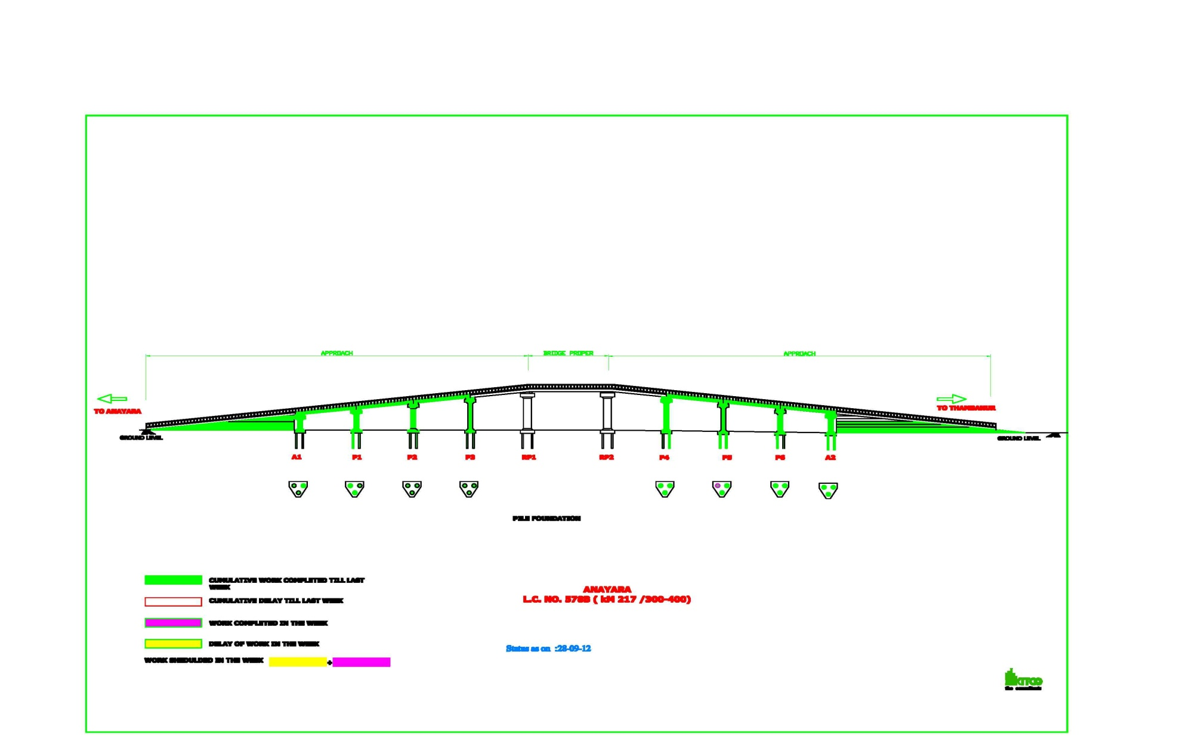
ONGOING PROJECT -8-ROB AT ANAYARA-PROGRESS GRAPH-28.09.12

Slide 26
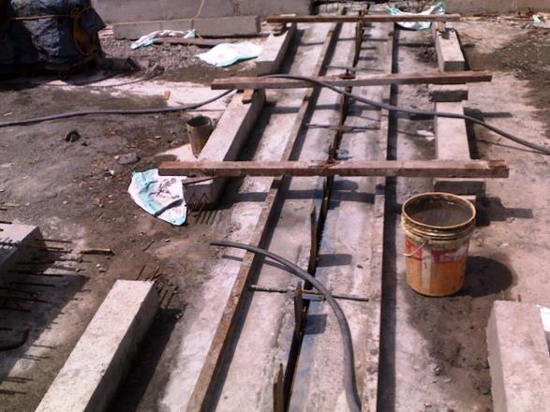
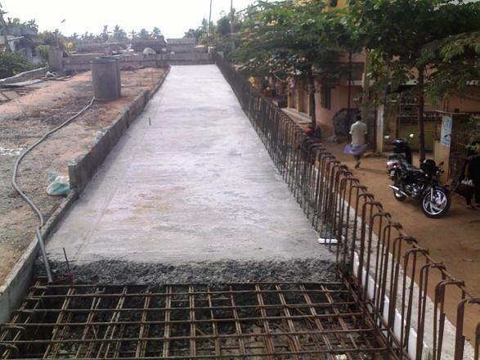
ONGOING PROJECT-8-PROGRESS PHOTOS-ROB AT ANAYARA-28.09.12

Slide 27
ANAYARA ROB-PROJECT STATUS REPORT AS ON SEPTEMBER 2012
Si No | Activity Description | Total Quantity | Cumulative progress upto Sep12 | Balance work up to Sep 12 | Cumulative delay in days from Baseline | Work planned for Sep 12 | Actual work done-Sep12 | Delay in Qty in Sep 12 | Work Planned for next Month | Remarks
1 | Pile-Pettah Side | 12 | 12 | 0 |  | 0 | 0 | 0
2 | Pile-Anayara Side | 12 | 12 | 0 |  | 0 | 0 | 0
3 | Pile cap-Pettah Side | 4 | 4 | 0 |  | 0 | 0 | 0
4 | Pile cap-Anayara Side | 4 | 4 | 0 |  | 0 | 0 | 0
5 | Pier-Pettah Side | 4 | 4 | 0 |  | 0 | 0 | 0
6 | Pier-Anayara Side | 4 | 4 | 0 |  | 0 | 0 | 0
7 | Pier Cap-Pettah Side | 4 | 4 | 0 |  | 0 | 0 | 0
8 | Pier Cap-Anayara Side | 4 | 4 | 0 |  | 0 | 0 | 0
9 | Girder-Pettah Side | 4 | 3 | 1 |  | 1 | 1 | 0
10 | Girder-Anayara Side | 4 | 3 | 1 |  |  |  | 0
11 | Deck Slab-Pettah Side | 4 | 2 | 2 |  | 1 | 1 | 0
12 | Deck Slab-Anayara Side | 4 | 3 | 1 |  |  |  | 0
13 | Handrails & Kerb-Pettahside | 100% | 0% | 100% |  | 0% | 0% | 0%
14 | Handrails & KerbAnayara side | 100% | 0% | 100% |  | 100% | 0% | 100%
15 | RE panel casting | 100% | 100% | 0% |  | 0% | 0% | 0%
16 | RE Wall-Pettah side | 100% | 88% | 12% |  | 12% | 12% | 0%
17 | RE Wall-Anayara side | 100% | 100% | 0% |  |  |  | 0%
18 | RC Wall-Pettahside | 100% | 100% | 0% |  |  |  | 0%
19 | RC Wall-Anayara side | 100% | 100% | 0% |  |  |  | 0%
20 | Expansion Joint-Pettahside | 100% | 0% | 100% |  | 0% | 0% | 0%
21 | Expansion Joint-Anayara side | 100% | 0% | 100% |  | 0% | 0% | 0%
22 | Road work-Pettah side | 100% | 25% | 75% |  | 0% | 0% | 0%
23 | Road Work-Anayara side | 100% | 25% | 75% |  | 0% | 0% | 0%

Slide 28
ONGOING PROJECT -9-ROB AT KORATTYANGADI-PROGRESS GRAPH-28.9.12

Slide 29
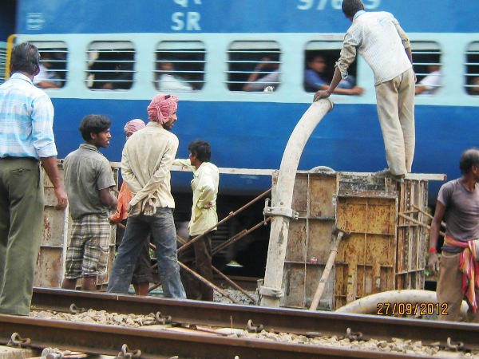
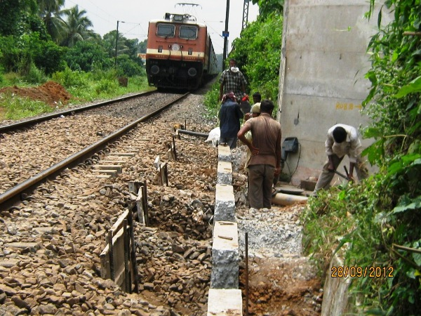
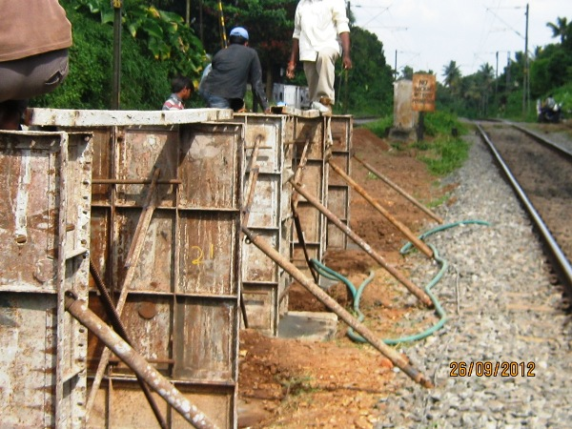
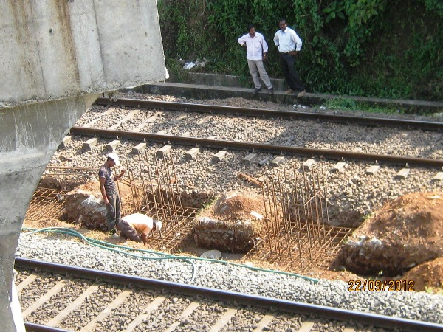
ONGOING PROJECT-9-PROGRESS PHOTOS-ROB AT KORATTYANGADI -28.09.12

Slide 30
KORATTYANGADI ROB-PROJECT STATUS REPORT AS ON KORATTY 2012
Si No | Activity Description | Total Quantity | Cumulative progress upto Sep12 | Balance work up to Sep 12 | Cumulative delay in days from Baseline | Work planned for Sep 12 | Actual work done-Sep12 | Delay in Qty in Sep 12 | Work Planned for next Month | Remarks
1 | Pile (approach portion) | 20 | 20 | 0
2 | Pile (Railway portion) | 18 | 18 | 0
4 | Pile cap (approach portion) | 5 | 5 | 0
5 | Pile cap (Railway portion) | 4 | 4 | 0
7 | Pier (approach portion) | 5 | 5 | 0
8 | Pier (Railway portion) | 4 | 4 | 0
9 | Pier cap (approach portion) | 5 | 5 | 0
11 | Pier cap (Railway portion) | 4 | 4 | 0
12 | Approach SPAN DECK | 5 | 5 | 0
14 | Railway Span Deck | 3 | 0 | 3
15 | Re wall towards NH side | 100% | 95% | 5%
16 | R0AD WORK | 100% | 50% | 50%
17 | Kerb/handrail (approach portion)N.H side | 100% | 90% | 10% |  | 10% | 0% | 10%

Slide 31
ONGOING PROJECT -10-RIVER BRIDGE ACROSS THOOTHAPUZHA CONNECTING EDAPPALAM AND MOORKKANAD-PROGRESS GRAPH-28.09.12

Slide 32
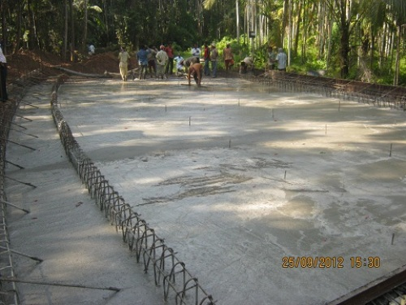
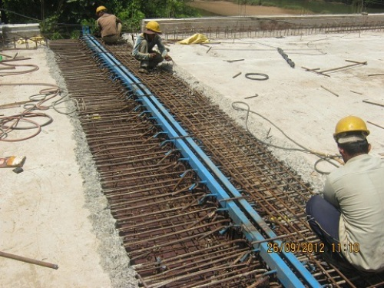
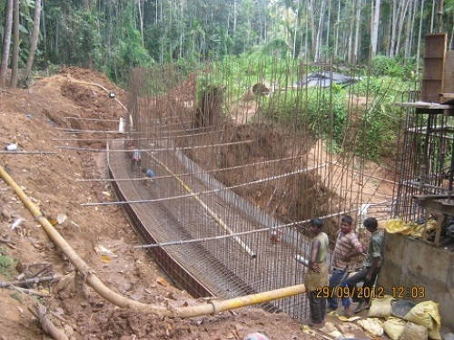
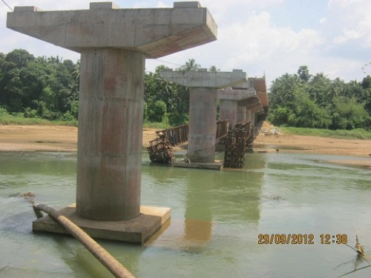
ONGOING PROJECT-10-RIVER BRIDGE ACROSS THOOTHAPUZHA CONNECTING EDAPPALAM AND MOORKKANAD-PROGRESS PHOTOS -28.09.12

Slide 33
EDAPPALAM-MORRKKANAD RIVER BRIDGE-PROJECT STATUS REPORT AS ON SEPTEMBER 2012
Si No | Activity Description | Total Quantity | Cumulative progress upto Sep12 | Balance work up to Sep 12 | Cumulative delay in days from Baseline | Work planned for Sep 12 | Actual work done-Sep12 | Delay in Qty in Sep 12 | Work Planned for next Month | Remarks
1 | Pile | 48 | 48 | 0
2 | Pilecap | 11 | 11 | 0
3 | Pier | 11 | 11 | 0
4 | Piercap | 11 | 11 | 0 |  |  |  | 0
7 | Girders | 10 | 7 | 3 |  | 0 | 0 | 0
8 | Deckslab | 10 | 7 | 3 |  | 1 | 1 | 0
9 | Handrails & footpath slab casting | 100% | 0% | 100%
10 | Retaining Wall Edapalam side | 100% | 100% | 0% |  | 10% | 10% | 0%
11 | Retaining Wall Moorkanad side | 100% | 25% | 75% |  | 0% | 25% | -25%
12 | Drain Works Moorkanad side | 100% | 0% | 100% |  | 100% | 0% | 100%
13 | Expansion Joint | 11 | 0 | 11 |  | 3 | 1 | 2
14 | Road work Edapalam side | 100% | 0% | 100%
15 | Road work Moorkanad side | 100% | 0% | 100%

Slide 34
ONGOING PROJECT-11-RIVER BRIDGE ACROSS PERIYAR CONNECTING STATIONKADAVU & VALIYAPAZHAMPILLITHURUTHU-PROGRESS GRAPH -28.09.12

Slide 35
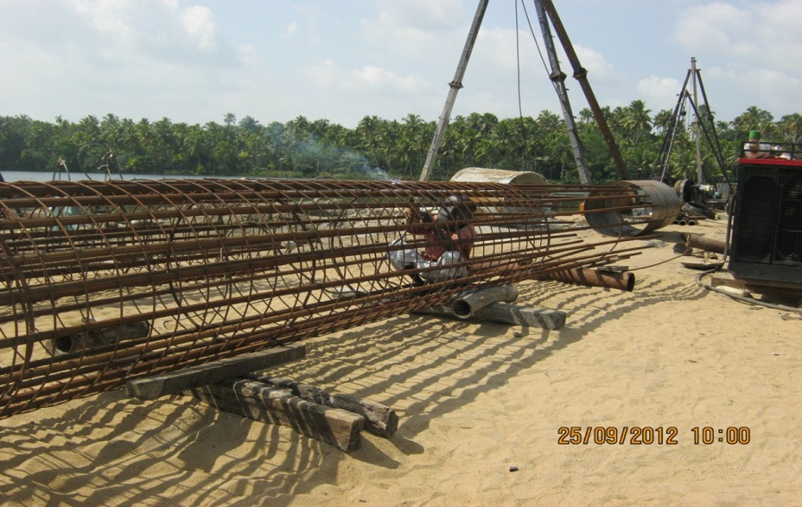
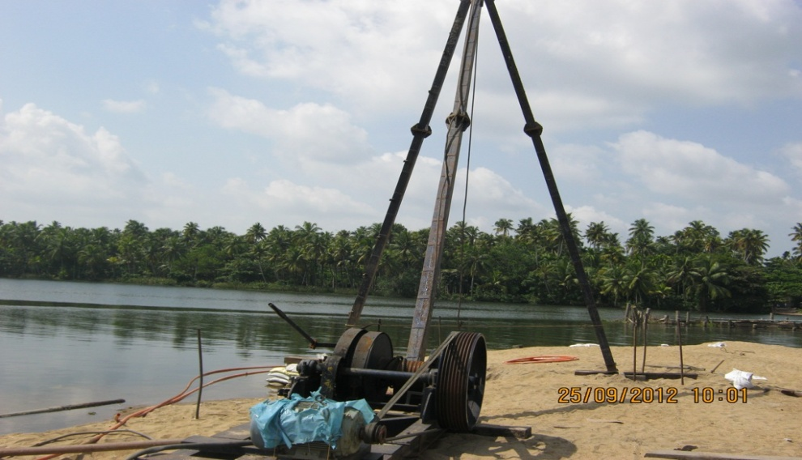
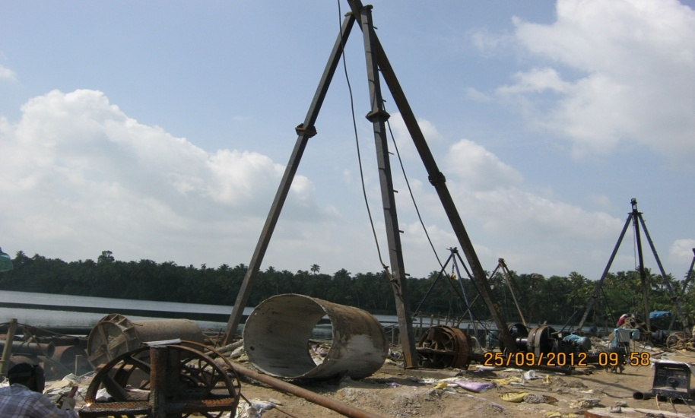
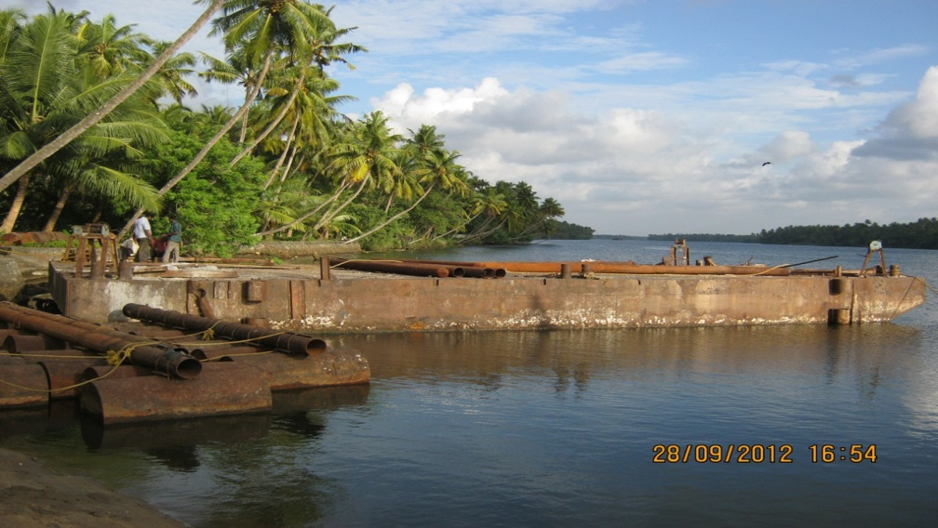
ONGOING PROJECT-11-RIVER BRIDGE ACROSS PERIYAR CONNECTING STATIONKADAVU & VALIYAPAZHAMPILLITHURUTHU-PROGRESS PHOTOS -28.09.12

Slide 36
STATIONKADAVU RIVER BRIDGE-PROJECT STATUS REPORT AS ON SEPTEMBER 2012
Si No | Activity Description | Total Quantity | Cumulative progress upto Sep12 | Balance work up to Sep 12 | Cumulative delay in days from Baseline | Work planned for Sep 12 | Actual work done-Sep12 | Delay in Qty in Sep 12 | Work Planned for next Month | Remarks
1 | Pile | 79 | 14 | 65 |  | 15 | 2 | 13
2 | Pilecap | 12 | 0 | 12 |  | 0 | 0 | 0
3 | Pier | 12 | 0 | 12 |  | 0 | 0 | 0
4 | Piercap | 12 | 0 | 12 |  | 0 | 0 | 0
7 | Girders | 11 | 0 | 11 |  | 0 | 0 | 0
8 | Deckslab | 11 | 0 | 11 |  | 0 | 0 | 0
9 | Handrails & footpath slab casting | 100% | 0% | 100% |  | 0 | 0 | 0
10 | Retaining Wall Paliyam side | 100% | 0% | 100% |  | 0 | 0 | 0
11 | Retaining Wall Thrissur side | 100% | 0% | 100% |  | 0 | 0 | 0
12 | Road work Paliyam side | 100% | 0% | 100% |  | 0 | 0 | 0
13 | Road work Thrissur side | 100% | 0% | 100% |  | 0% | 0% | 0%

Slide 37
THANK YOU

